Slide 1

welcome to our project
Name: Kasthurimounika Paidisetti
Specialization: BSC .data science
Branch: AWDC KKD
SUC : 2347390580

Slide 2
SALES ANALYSIS DASHBOARD
OF DATASET.
POWER BI

Slide 3
USING POWER BI
DATASET SOURCE:
KAGGLE

Slide 4
PROJECT OVERVIEW :
OBJECTIVE: TO analyze sales data using power bi and extract values insights.
TOOLS USED: power bi, and power query.

Slide 5
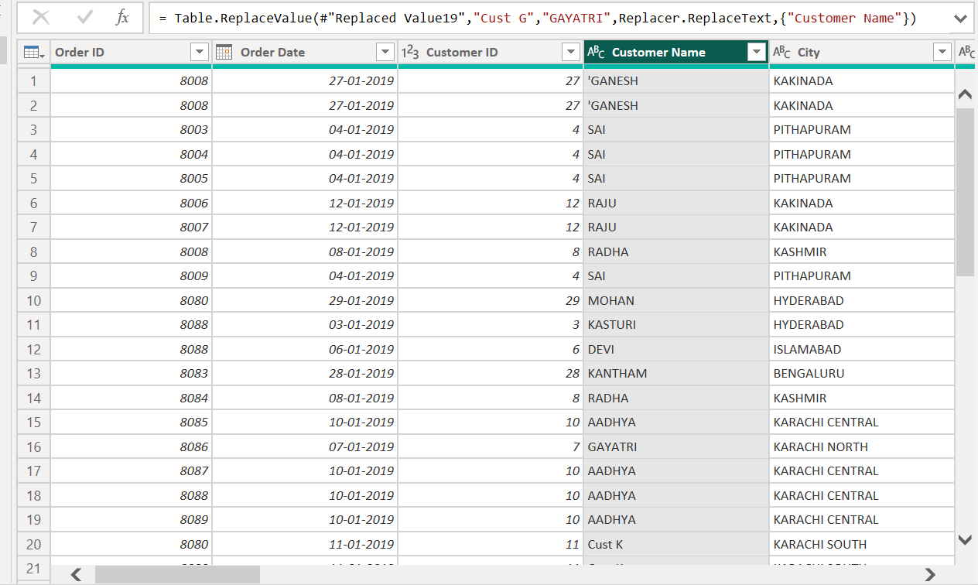
RENAME COLUMN :
Renaming a column was means changing the name lable or header of a column a data table to something more meaningful, readable, or standard like( EMP_ID )to change Rename column EMPLOYEE_ID.

Slide 6
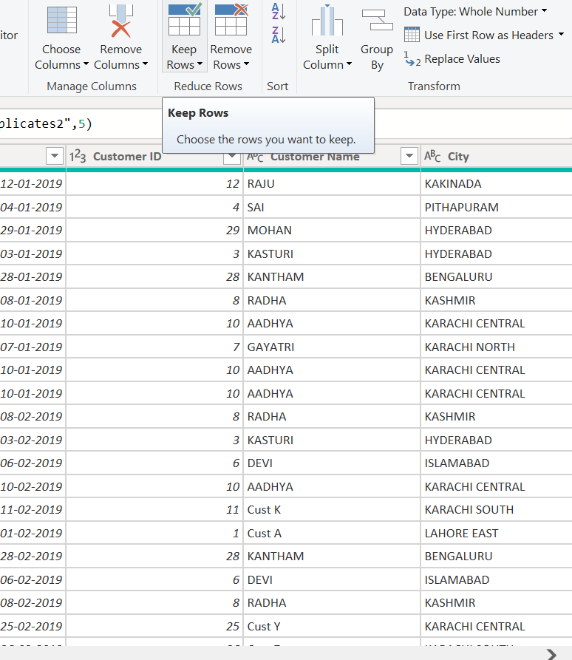
REMOVE COLUMN & ROWS
The remove column and rows unwanted duplicated data can delete remove any null values.

Slide 7
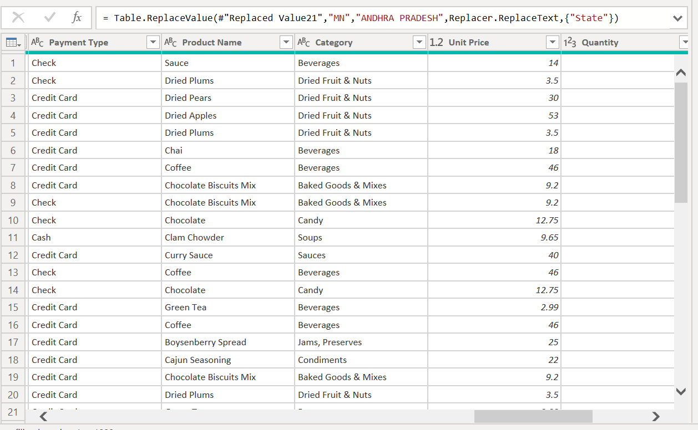
USE FIRST ROW AS HEADER:
in the use first row as header it can change in columns name replace in given name like customer name and payment type replacing in header they can more use in first row as header.

Slide 8
Conditional column
1. GO to transform data > power query editor.
2. click on add column > conditional column
3. in the dialog
Choose the column
Deffine condition.
Set output value.
Optionally and add else value
4. Click ok

Slide 9
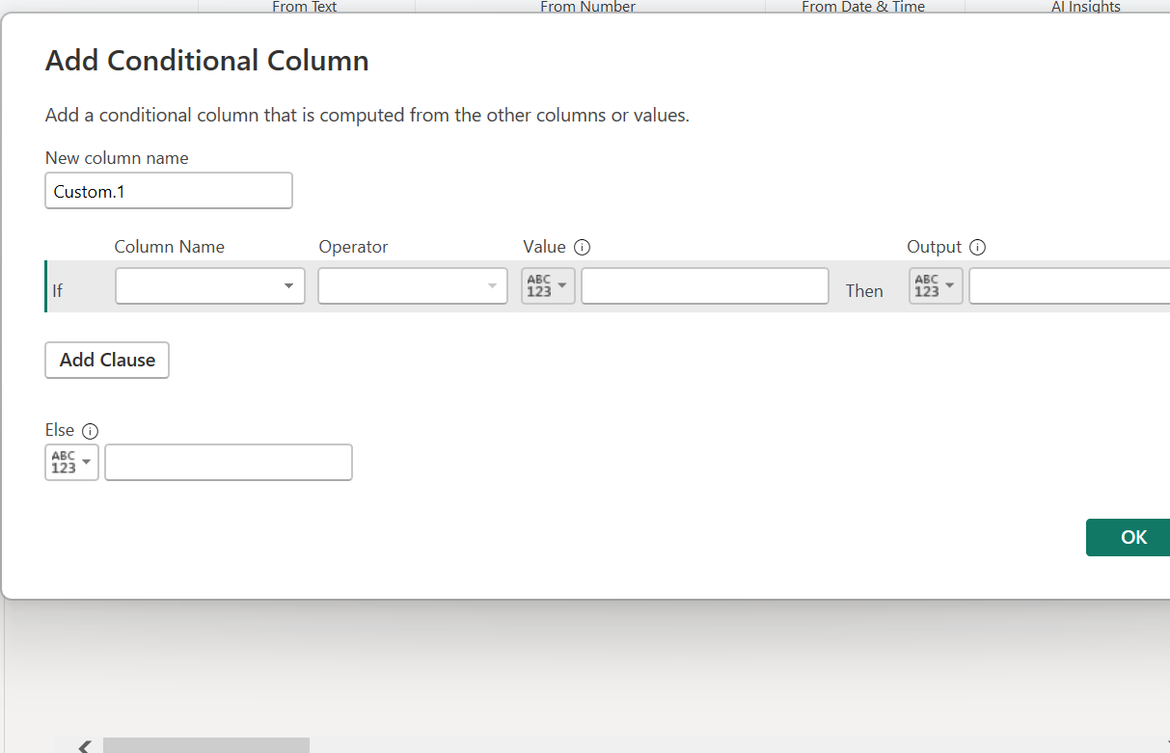
It is condition column

Slide 10
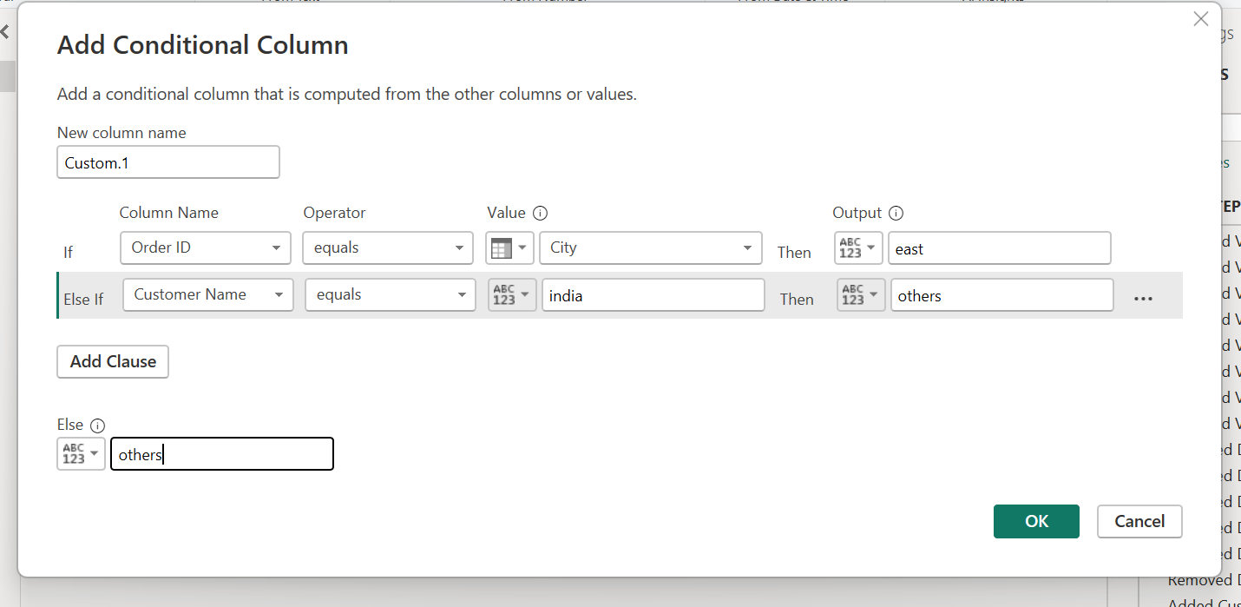

Slide 11
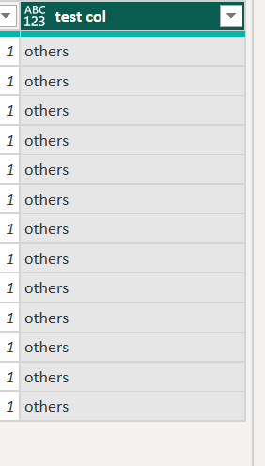
Which output you can give they represent in dataset
Notes:
I’m give in conditional column in output others present in data

Slide 12
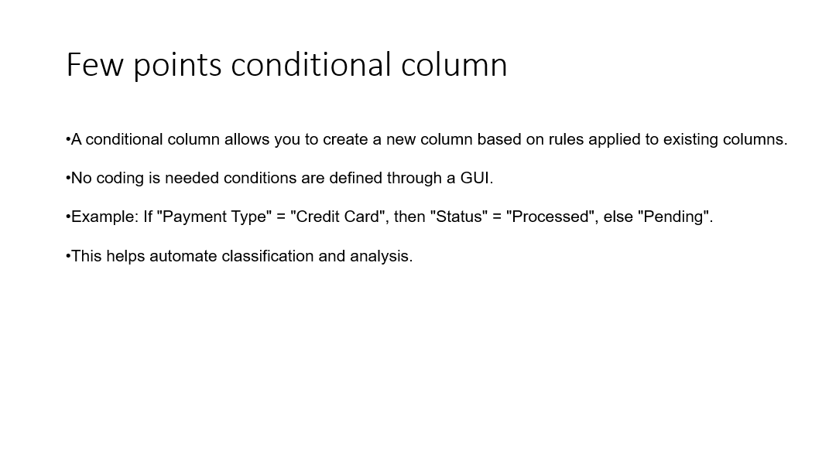

Slide 13
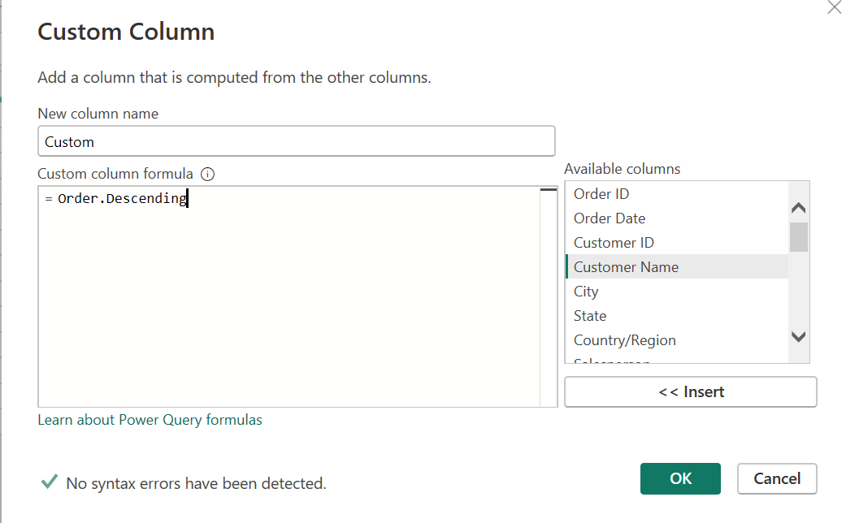
Custom column:

Slide 14
Replace values :
You can replacing variables identifiers like take example
Example, karachi central
to replacing
vizag

Slide 15
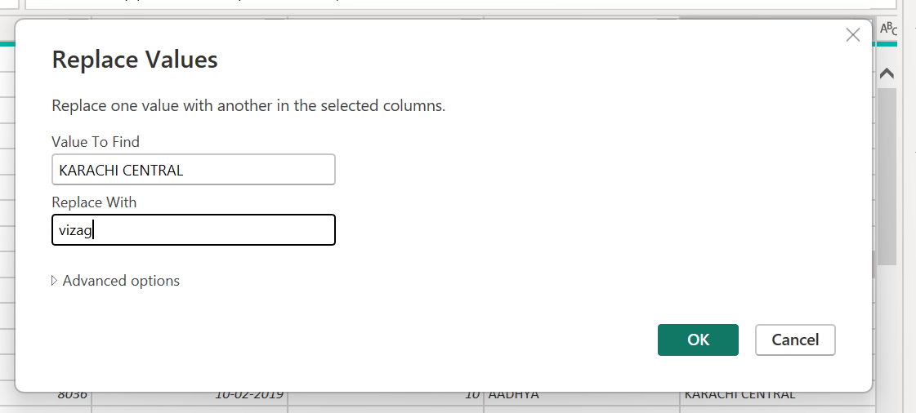
Sample image

Slide 16
Pivot:
.Group by summarize data(e.g , total sales by region)
.Rearrange pivot rows and columns.
.apply function like sum, count, average, etc.
Example
Original data
Region product sales
East shampoo 100
East hairconditioner 150
West dress 400
> pivot sum of sales
region a b
East 100 150
West 400

Slide 17
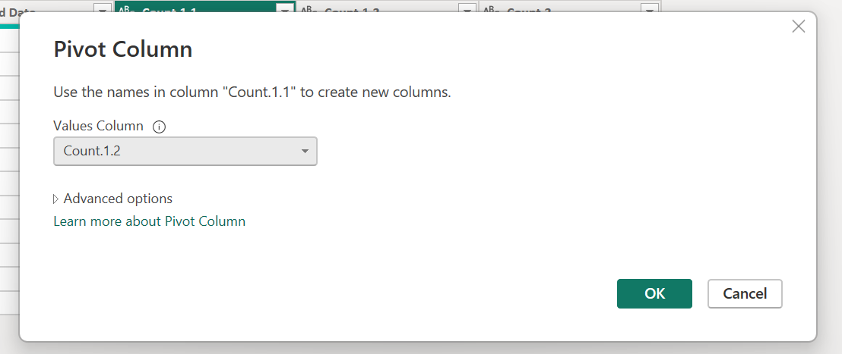

Slide 18
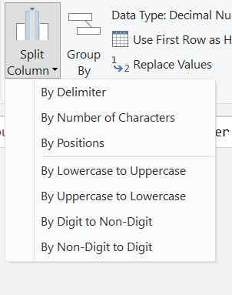
Split column
In these split column to break a single column to multiple parts, like separting
You can see image split column by delimiter like perform it.

Slide 19
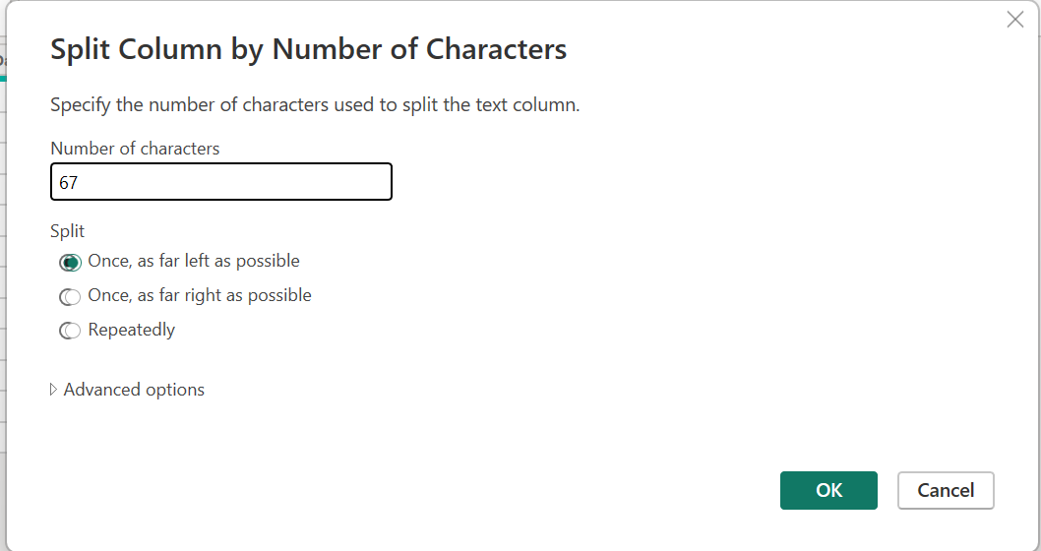
Here you can see
67 column was split number of characters in left possible.

Slide 20
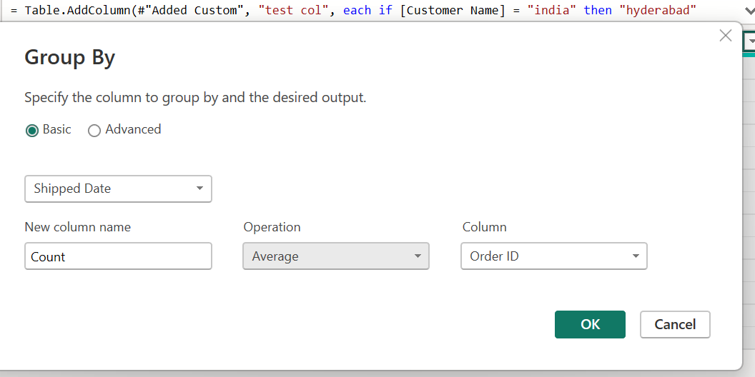
Group by

Slide 21
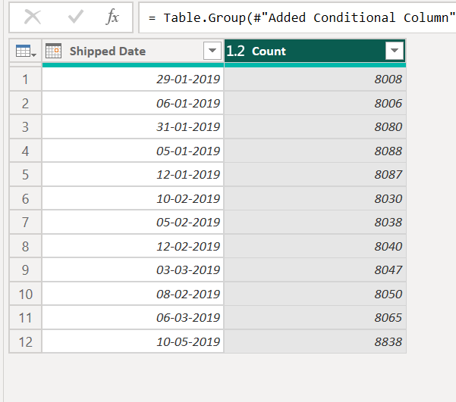
Group by I can choose in basic pick shipped date and order id only these two based who can person order id product shipping time date

Slide 22
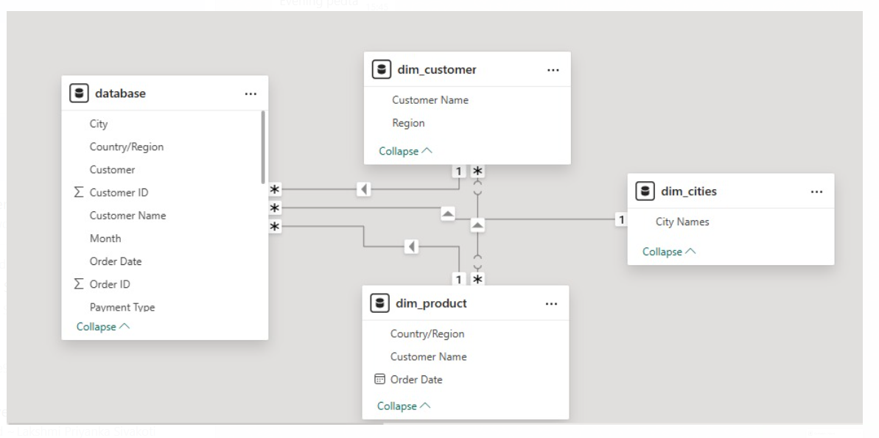
Data modelling

Slide 23
cardinality
One to one
One to may
Many to one
Many to many

Slide 24
What is Visualization?
Visualization is the graphical representation of information and data using charts,
graphs, maps, and other visual elements. It helps to make complex data easier to understand and analyze.
We use visualization to quickly identify patterns, trends, and outliers in data, which supports better decision-making and communication of insights.
We can more in piechart, donut chart , stacked column char, table ,barchart
They are many visualizations in power BI for example in pie chart can give in city and payment type represents in different colors.

Slide 25
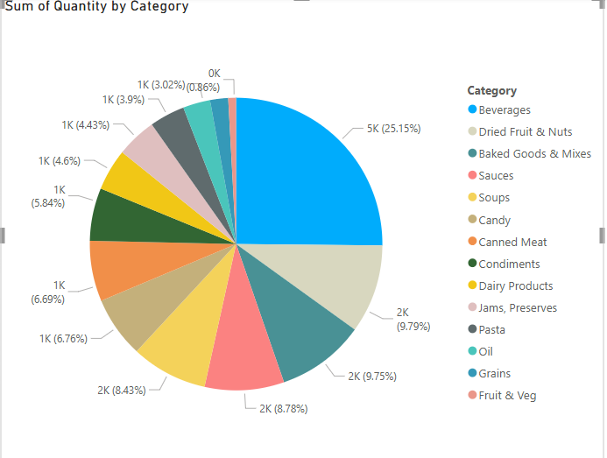
Piechart: sum of Quantity by category > used to show in piechart which category like candy how many customers can buy it. Show in percentage.

Slide 26
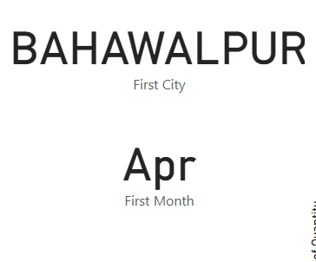
CARD VISUALS: > choosen in sum of first city in place Bahawalpur. > taken in column first month April.

Slide 27
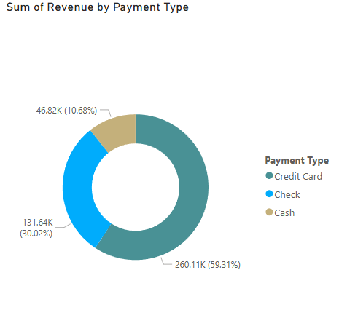
Donut chart: > sum of revenue by payment type. > Used visualize payment type.

Slide 28
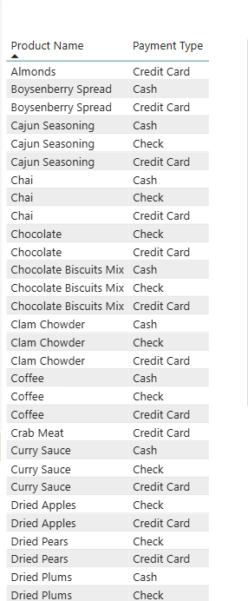
Table: > product name and payment type. > used to visualize detailed understand product and payment type.

Slide 29
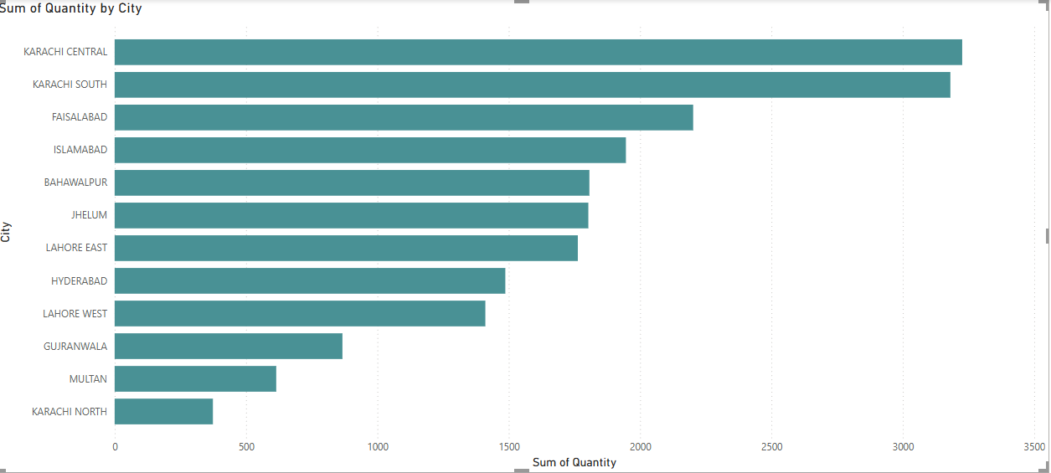
Barchart: > sum of quantity and by city. > consider and used to which city members more quantity can but it in product

Slide 30
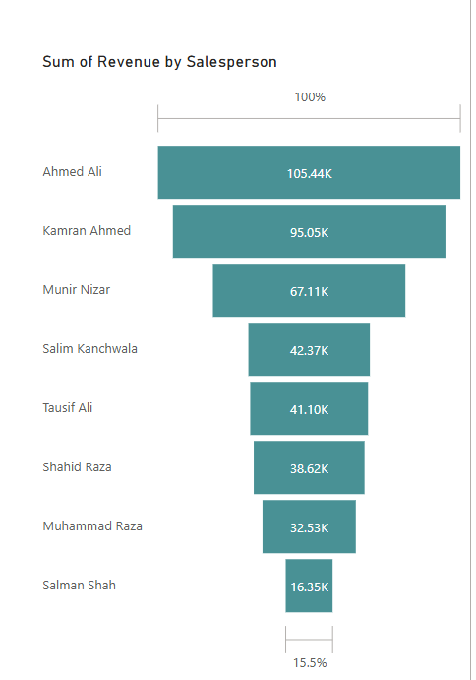
Funnel chart: > sum of revenue > we can divide in each sales person count product revenue>

Slide 31
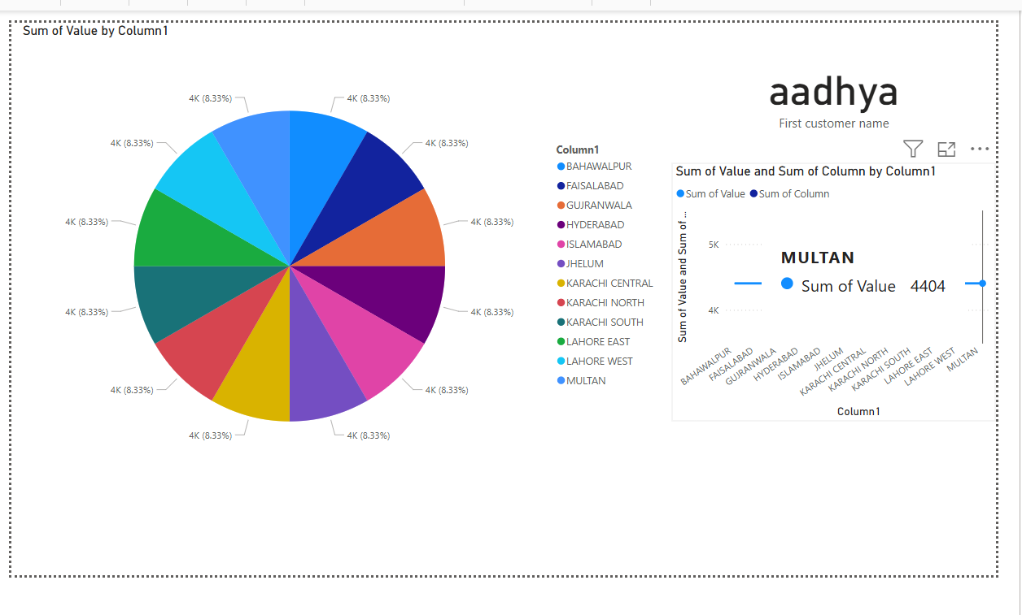
DASHBORDS:

Slide 32
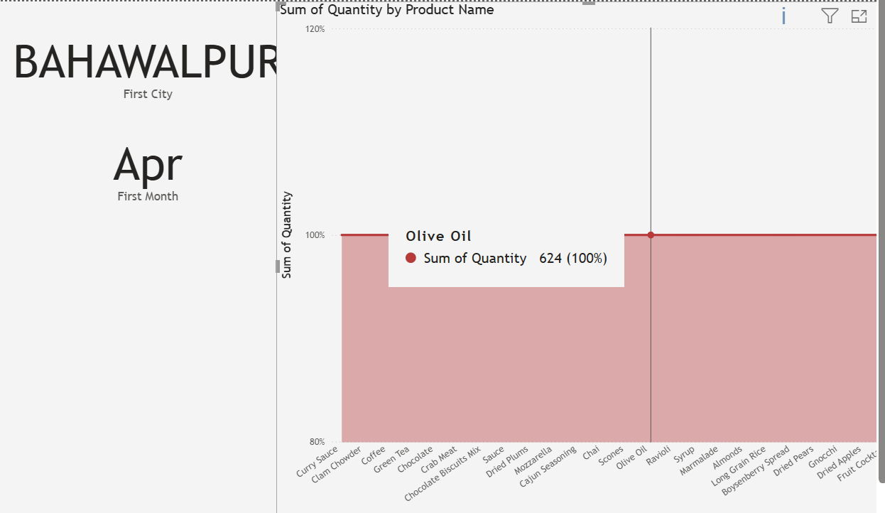

Slide 33
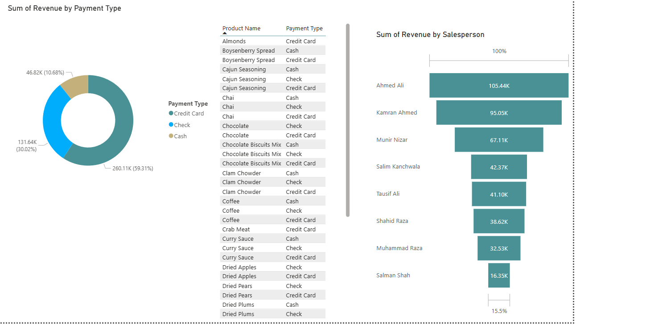

Slide 34
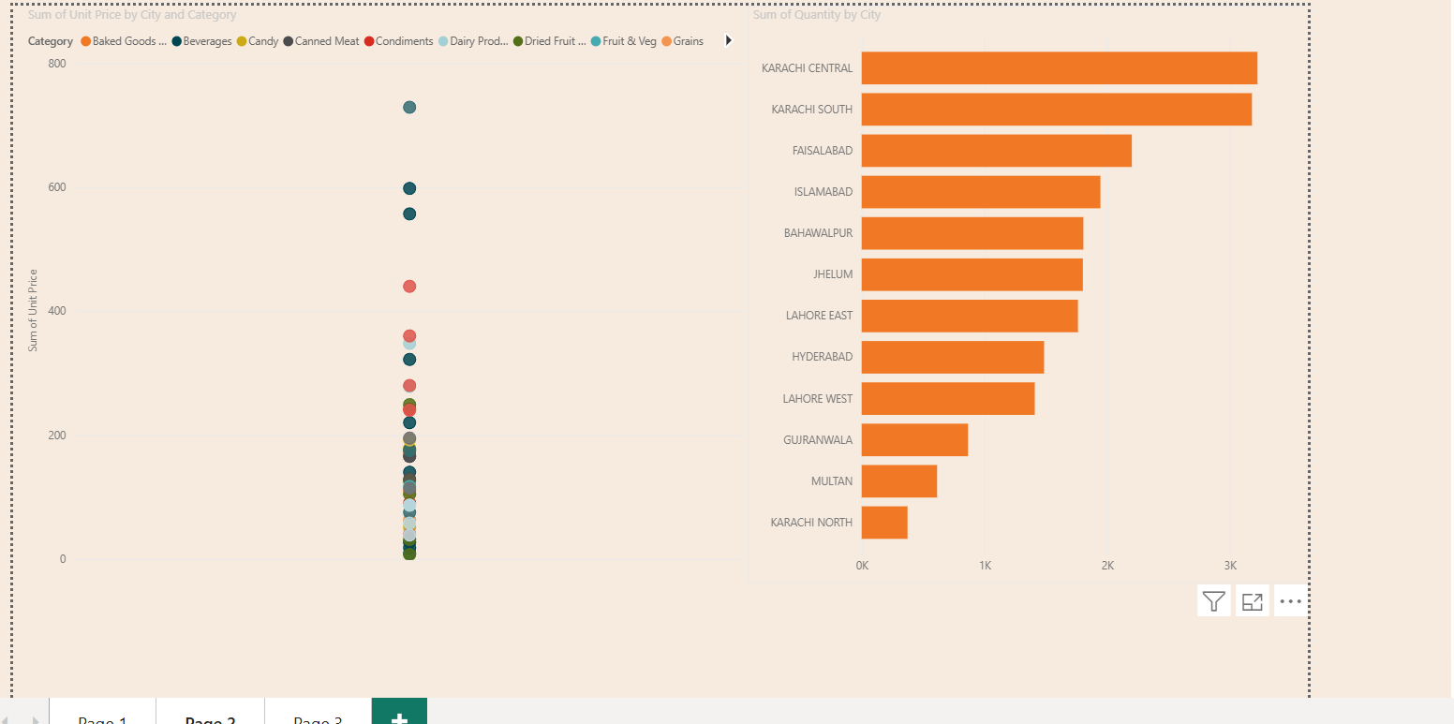

Slide 35
THANKYOU

